Slide 1
Session 1
Module 1: Introduction to Data Integrity
Module 2: Introduction to Indexes

Slide 2
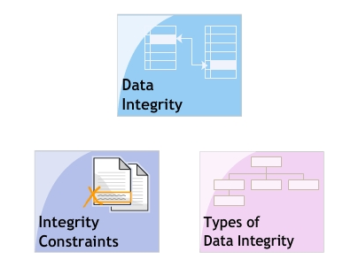
Introduction to data integrity
Objectives

Slide 3
Data Integrity
Need for updating data.
Need for ensuring the validity and consistency of data at all times: data integrity.
Integrity of data can be maintained by specifying certain checks at the time of creating and modifying tables and then applying those checks when handling data.

Slide 4
Rules for Data Integrity
Uniqueness
Validity
Consistency
Business Rules

Slide 5
Enforcing Data Integrity
SQL Server 2005 supports four mechanisms:
  Constraints: are properties that assigned to columns in a table to prevent invalid data from being entered into the columns.
  Default Values: do not accept null values.
  Rules: to control the data values being entered in a table.
  Triggers: contains T-SQL statements that is automatically executed when specified events occur.

Slide 6
Types of Data Integrity
Entity Integrity
Domain Integrity
Referential Integrity
User-defined Integrity

Slide 7
Entity Integrity - 1
A table in a database represents an entity whereas each record within the table represents an instance of that entity.
A table is said to comply with entity integrity when no two rows in the table have the exact same values in all the columns.

Slide 8
Entity Integrity - 2
Entity integrity is ensured using:
  PRIMARY KEY constraint: does not allow duplicate or null values to be inserted.
  UNIQUE constraint: does not allow duplicate but allows null values to be inserted. However, this column allows a null value to be inserted once.
  Indexes: prevents duplicate values from being entered in a column.
  IDENTITY property: defines an identifier column that contains system-generated sequential values for every record inserted.

Slide 9
Domain Integrity - 1
A domain defines a logical set of values that make up the valid values in a column.
Domain integrity is maintained using the following:
  FOREIGN KEY constraint: a FOREIGN KEY column can either have a value that exists in the UNIQUE or PRIMARY KEY columns of the referenced table or it can have a null value.
  CHECK constraint: specifies the range of valid data values that can be entered into a column.

Slide 10
Domain Integrity - 2
  DEFAULT definitions: specify default values for columns that do not accept null values.
  NOT NULL definitions: specifies a column cannot accept NULL values (unspecified or unknown).
  Data Types.
  Rules: specify the valid data formats or range for values in a column.

Slide 11
Referential Integrity - 1
Referential integrity maintains consistency of data across tables that are related through common columns.
Referential integrity is implemented using the concept of FOREIGN KEYS. FOREIGN KEYS columns reference UNIQUE or PRIMARY KEY columns in other tables.

Slide 12
Referential Integrity - 2
Referential integrity is ensured by the following rules:
  Values can be inserted in a FOREIGN KEY column only if similar values exist in the referenced UNIQUE or PRIMARY KEY column.
  If a value in the UNIQUE or PRIMARY KEY column is modified, similar modifications are carried out in the referring FOREIGN KEY columns.
  If a value in the UNIQUE or PRIMARY KEY column is deleted, deletion should be carried out in the referring FOREIGN KEY columns.

Slide 13
User-defined Integrity
Default integrity constraints provided by SQL Server 2005 may not be enough to ensure data values in a desired format or range. In such cases, special user-defined constraints can be applied to columns to maintain data integrity.

Slide 14
Integrity Constraints
Constraints can be defined at two level: column and table.
  A column-level constraint is a part of the column definition and applies only on that particular column.
  A table-level constraint declaration is independent from a column definition and can be simultaneously applied to multiple columns in the table.

Slide 15
UNIQUE Constraint
A UNIQUE constraint can be applied to a column or a combination of columns to ensure uniqueness of data values in these columns.
UNIQUE constraint can be defined on a column or a combination of columns within the CREATE TABLE or ALTER TABLE statement.

Slide 16
CHECK Constraint
CHECK constraint defines the range and format for the values entered in a column.
CHECK constraint can be specified on a column within the CREATE TABLE or ALTER TABLE statement.

Slide 17
PRIMARY KEY Constraint
The purpose of a PRIMARY KEY column is to uniquely identify each record within a table.
A PRIMARY KEY can be specified either on a single column or a combination of columns.
A PRIMARY KEY constraint can be specified within the CREATE TABLE or ALTER TABLE statement.
A table can have only one PRIMARY KEY.
A PRIMARY KEY column does not accept null values.

Slide 18
FOREIGN KEY Constraint
A FOREIGN KEY constraint is used to create a link between the data present in two tables.
The column specified with the FOREIGN KEY constraint should have reference to the PRIMARY KEY or the UNIQUE column.
A FOREIGN KEY constraint can be specified within the CREATE TABLE or ALTER TABLE statement.
A table can have multiple FOREIGN KEY columns.
The data type of the FOREIGN KEY column and of the referred PRIMARY KEY or the UNIQUE column should be the same.
FOREIGN KEY columns from multiple tables can reference the same PRIMARY KEY column.

Slide 19
Cascading Options
When records in the referenced PRIMARY KEY table are modified, changes can be cascaded to corresponding records in the referring FOREIGN KEY table. This way is used to maintain the referential integrity.
The cascading options are defined in the REFERENCES clause of the CREATE TABLE or ALTER TABLE statement.
SQL Server 2005 provides the following two cascading options:
  Cascading Update.
  Cascading Delete.

Slide 20
Module 1 - Summary
Data Integrity
  Data Integrity ensures accurate and up-to-date information at any point in time.
  In SQL Server 2005, data integrity is enforced using Constraints, Default Values, Rules and Triggers.
Types of Data Integrity
  To maintain accuracy and consistency of data in a relational database.
  Four types of integrity checks: Entity Integrity, Domain Integrity, Referential Integrity, User-defined Integrity.
Integrity Constraints
  To ensure validity and consistency of data in a database.
  SQL Server 2005 supports UNIQUE, CHECK, PRIMARY and FOREIGN KEY constraints on columns in a table.

Slide 21
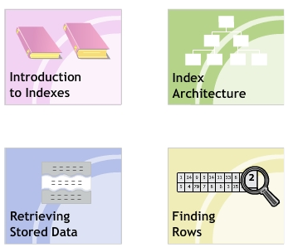
Module 2 - Introduction to Indexes
Objectives

Slide 22
Need for Indexes
In a table, records are stored in the order in which they are entered (unsorted). When data is to be retrieved from such tables, the entire table needs to be scanned. This slows down the query retrieval process.
When an index is created on table, the index creates an order for the data rows or records in the table. This assists in faster location and retrieval of data during searches.

Slide 23
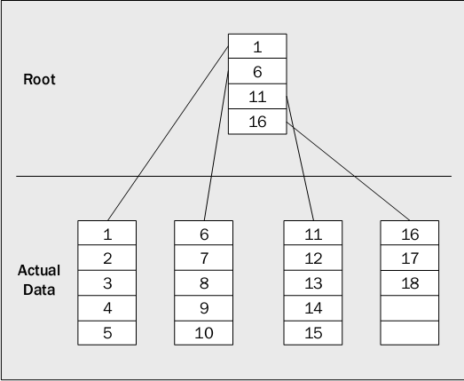

Slide 24
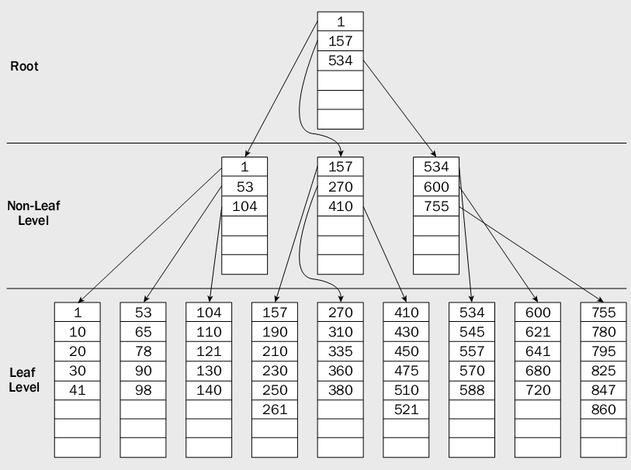

Slide 25
Guidelines about Indexes
Indexes increase the speed of queries that join tables or perform sorting operations.
Indexes implement the uniqueness of rows if defined when you create an index.
Indexes are created and maintained in ascending or descending order.
Indexes are useful when data needs to be accessed group-wise.
Indexes should not be created if they are not used frequently since, maintaining them requires time and resources.
Indexes should not be created on columns having duplicate data.

Slide 26
Indexes Architecture
In SQL Server 2005, all indexes are structured in the form of B-Trees.
Root Node
Intermediate Nodes
Leaf Nodes

Slide 27
Index B-tree Structure
Index
Page
Root Node
Index
Page
Index
Page
Intermediate Nodes
Index/
Data Page
Index/
Data Page
Index/
Data Page
Index/
Data Page
Root Node: contains an index page with pointers pointing to index pages at the first intermediate level.
Intermediate Nodes: contains an index pages with pointers pointing either to index or data pages at the leaf level.
Leaf Nodes: contains either data pages or index pages that point to data pages.

Slide 28
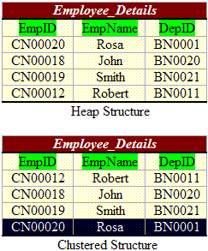
Index Architecture
In SQL Server 2005, data in the database can be stored either in a sorted manner (a clustered structure) or at random (a heap structure) .

Slide 29
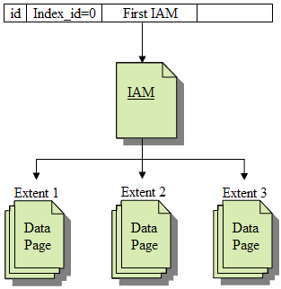
Heap Structures
In a heap structure, the data pages and records are not arranged in sorted order. The only connection between the data pages is the information recorded in the Index Allocation Map (IAM) pages.
IAM pages are used to scan through a heap structure. IAM pages map extents that are used by an allocation unit in a part of a database file.
You can read a heap by scanning the IAM pages.

Slide 30
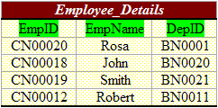
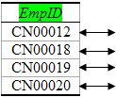
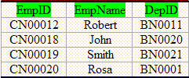
Clustered Indexes
A clustered index causes records to be physically stored in a sorted or sequential order. You can create only one clustered index in a table.
Uniqueness of a value in a clustered index is maintained explicitly using the UNIQUE keyword or implicitly using an internal unique identifier.
A clustered index is organized in the form of a B-tree. The actual data rows in the data pages present at the leaf level of the index.
Clustered Index created

Slide 31
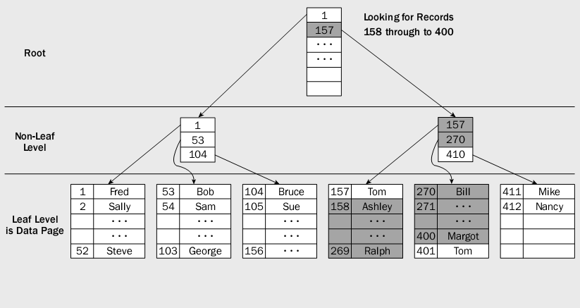
Clustered Indexes

Slide 32
Guidelines
A clustered index is automatically created on a table when a primary key is defined on the table.
A clustered index should ideally be defined on:
  Key columns that are searched on extensively.
  Columns used in queries that return large result sets.
  Columns having unique data.
  Columns used in table joins.

Slide 33
Nonclustered Indexes
A nonclustered index is defined on a table that has data either in a clustered structure or a heap. Nonclustered index will be the default type if an index is not defined on a table.
Nonclustered indexes have a similar B-tree structure as clustered indexes but with the following differences:
  The data rows of the table are not physically stored in the order defined by their nonclustered keys.
  In a nonclustered index structure, the leaf level contains index rows.

Slide 34
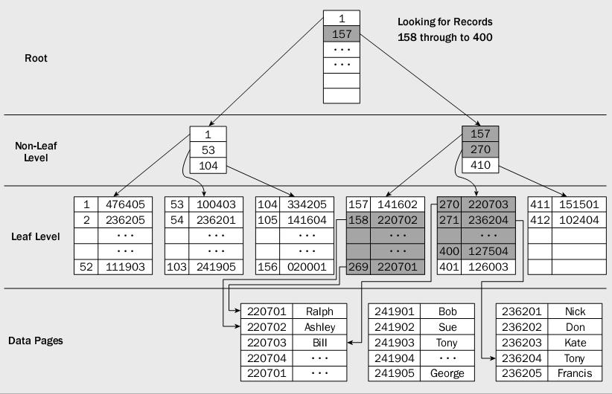
Nonclustered Indexes

Slide 35
Guidelines
Nonclustered indexes are useful when you require multiple ways to search data.
  When a clustered index is re-created or the DROP_EXISTING option is used, SQL Server rebuilds the existing nonclustered indexes.
  A table can have up to 249 nonclustered indexes.
  Create clustered index before creating a nonclustered index.

Slide 36
XML Indexes
XML indexes can be created on a table only if there is a clustered index based on the primary key of the table. This primary key cannot exceed 15 columns.
There are two types of XML indexes:.
  Primary XML Indexes: special indexes that shreds the XML data to store information.
  Secondary XML Indexes: help with specific XML queries.
    Searching for values anywhere in the XML document.
    Retrieving particular object properties from within an XML document.

Slide 37
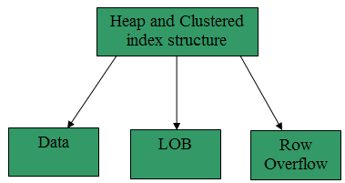
Allocation Units
A heap or a clustered index structure contains data pages in one or more allocation units. An allocation unit is a collection of pages and is used to manage data based on their page type.
The types of allocation units that are used to manage data in tables and indexes are: IN_ROW_DATA, LOB_DATA, ROW_OVERFLOW_DATA.

Slide 38
Finding Rows without Indexes
SQL Server uses catalog views to find rows when an index is not created on a table. It uses the sys.indexes view to find the IAM page.
When the sys.indexes view is used, the query optimizer checks all rows in a table and extracts only those rows that are referenced in the query. This scan generates many I/O operations and utilizes many resources.

Slide 39
Finding Rows with Nonclustered Index
The pointers in the leaf level of the index point to the storage location of the data in the underlying table.
The nonclustered index is used to search for exact-match queries. This is because the index contains entries describing the exact location of the data in the table.
For finding rows with nonclustered indexes, a SELECT statement is used with the nonclustered index column specified in the WHERE clause.

Slide 40
Finding Rows in a Clustered Index
Clustered Indexes store the data rows in the table based on their key values.
For finding rows using clustered indexes, a SELECT statement is used with the clustered index column specified in the WHERE clause.

Slide 41
Module 2 - Summary
Index is used for faster retrieval of data. When an index is created on a table, the index creates an order for the data rows or records in the table.
All indexes are structured in the form of B-Trees.
Indexes types
  Clustered indexes
  Non-clustered indexes
  XML indexes

